Slide 1
7th Week Kick Off Presentation
Date: 11th Nov. 2025

Slide 2
Weekly report: Grid code Developement
Week number: 7
Date: 11/11/2025
Supervisor: Prof. Dr. –Ing. Rajesh Saiju
Presented by: Vijay Bogala / Josef Remberger

Slide 3
List of contents
Milestones
Harmonics
Hardware for Grid Code regulation
PowerFactory
Load profile
Grid Code Development / Optimus Syria
Vijay Bogala
Grid Code Development / Optimus Syria

Slide 4
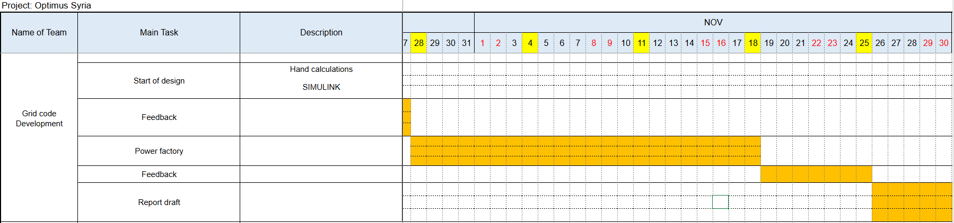
1. Milestones
Vijay Bogala
Grid Code Development / Optimus Syria

Slide 5
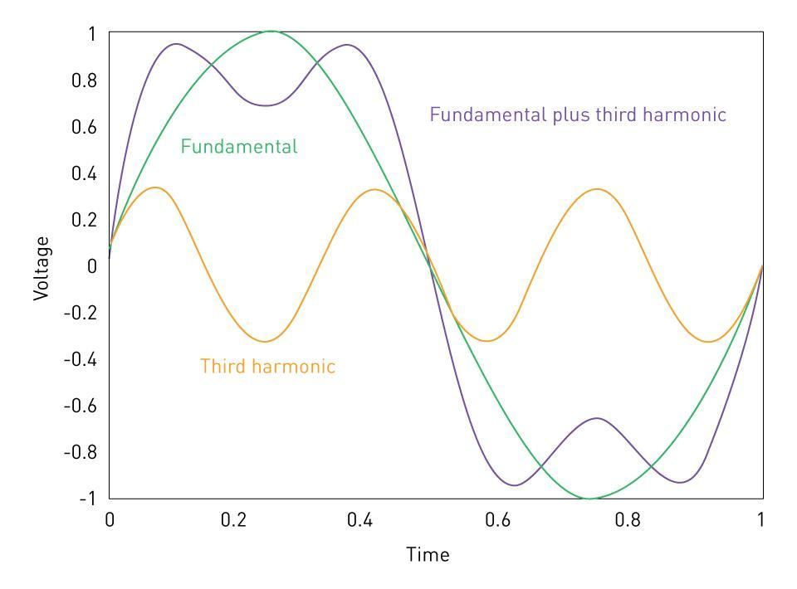
2. Harmonics
voltage or current waveforms whose frequencies are integer multiples of the fundamental power frequency (50 Hz).
Cause: Non-linear loads e.g. pulsating electronics
Effects:
increase heating
reduce the efficiency
create resonance conditions in the grid
disrupt communication signals
cause neutral conductor overheating
Harmonic Distortion in Waveforms, [1], accessed 08/11/2025
[1]
Vijay Bogala
Grid Code Development / Optimus Syria

Slide 6
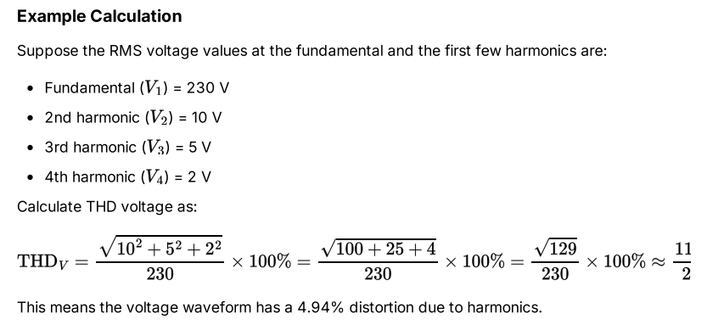
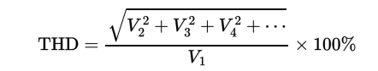
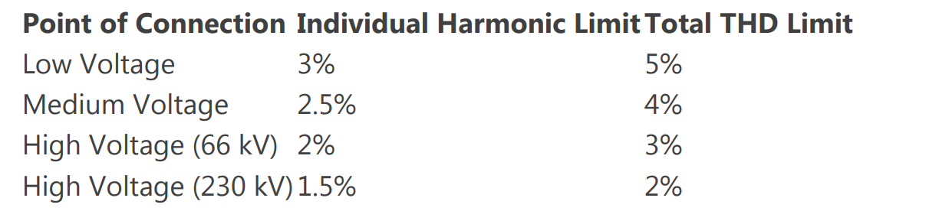
2. Harmonics
More often calculated on I than V.
According to Syrian standards:
[1], [2]
Vijay Bogala
Grid Code Development / Optimus Syria

Slide 7
3. Hardware for Grid Code regulation
“Smart” Inverter
- Provides grid services to help sustain reliable grid operations
Power Plant Controller
- Taking system operator requests as input data/orders
- Monitors electrical values at the point of common coupling (PCC)
- Commands and computed set points are transmitted to the devices
[3], [4]
Vijay Bogala
Grid Code Development / Optimus Syria

Slide 8

3. Hardware for Grid Code regulation
Protection relays and switchgears
- Identify / trigger the control circuit and isolate faulty areas from operational networks
-> conventional relays becoming more and more obsolete because of pre-defined fixed settings which are failing due to bidirectional power flow and intermittent characteristics
Monitoring and measurement hardware
- high-speed and high-accuracy meters like phasor measurement units (PMU)
[5], [6], [7]
Phasor measurement unit example, [6], accessed 09/11/2025
Vijay Bogala
Grid Code Development / Optimus Syria

Slide 9
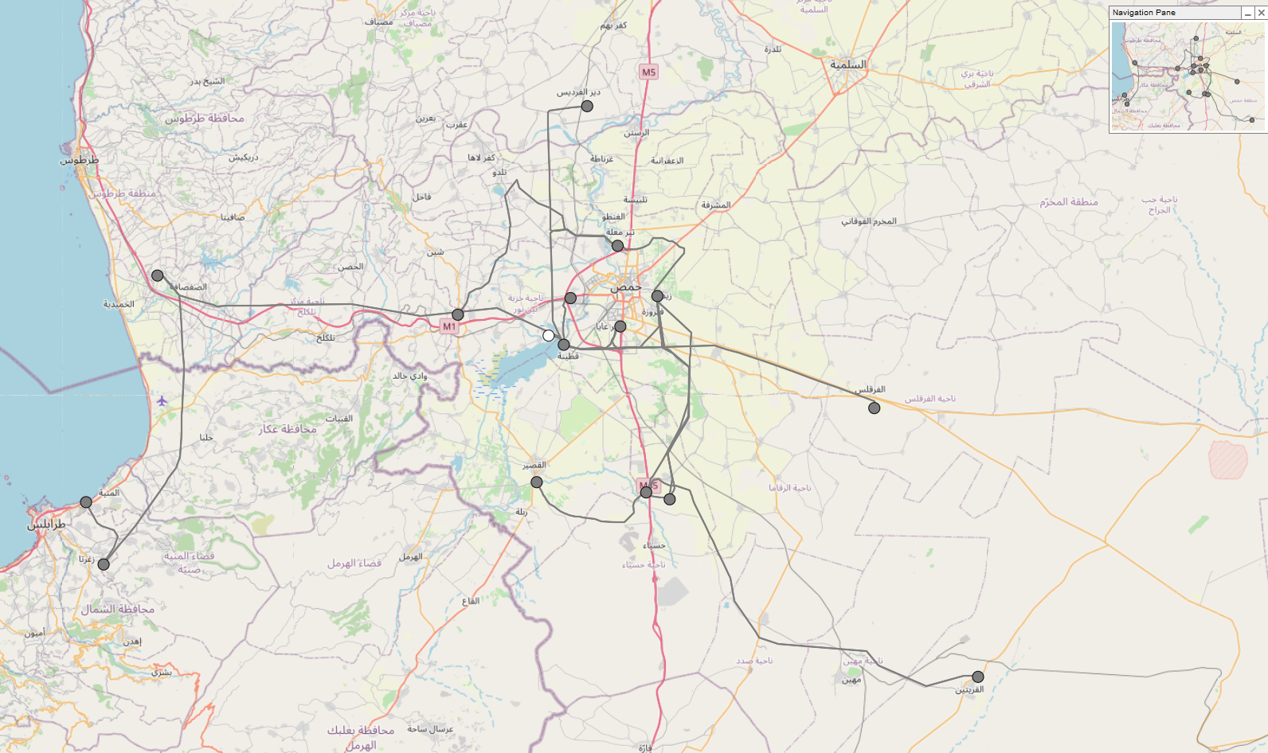
4. PowerFactory
Grid Overview
[8]
Vijay Bogala
Grid Code Development / Optimus Syria

Slide 10
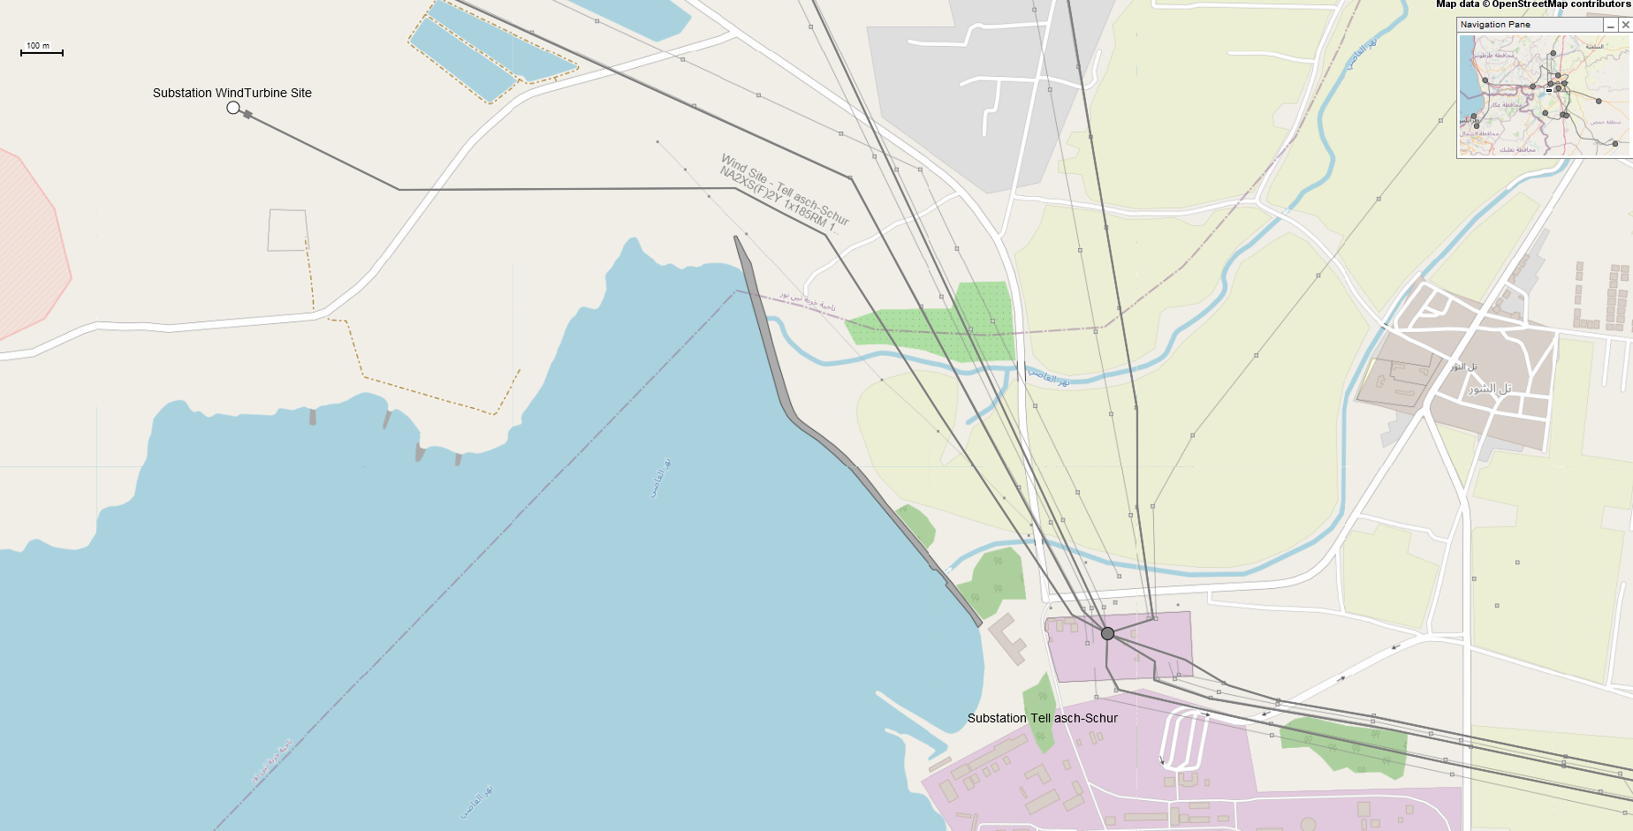
4. PowerFactory
Grid Connection Wind Turbine Site – Substation Qattinah
[8]
Vijay Bogala
Grid Code Development / Optimus Syria

Slide 11
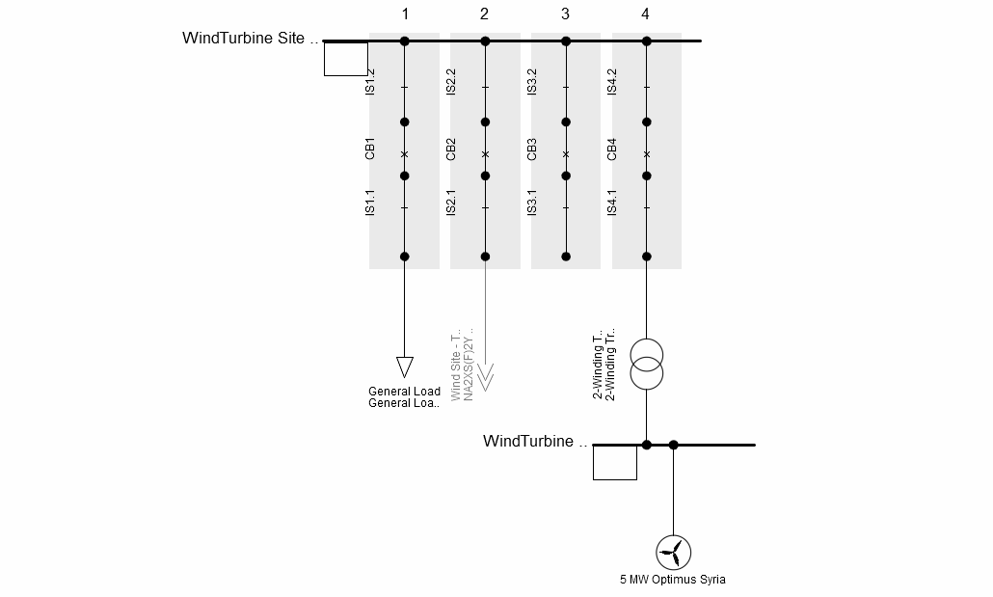
4. PowerFactory
Substation Wind Turbine Site
[8]
Vijay Bogala
Grid Code Development / Optimus Syria

Slide 12
5. Load profile
Only monthly avg. MWh available
Load profiles needed: full (last 5 years), Average: hourly, daily, weekly, monthly
Must be assumed and reconstructed
Based on Hot climate grids and pre-war data
[9]
Vijay Bogala
Grid Code Development / Optimus Syria

Slide 13
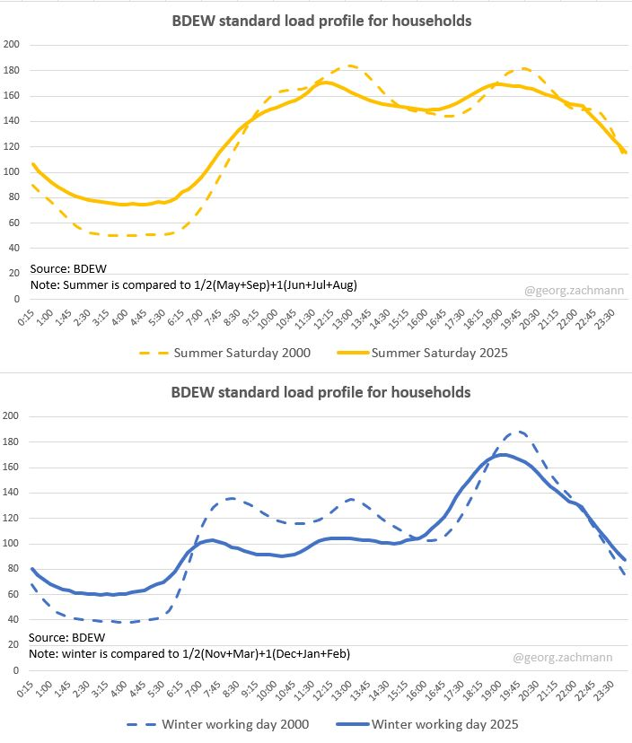
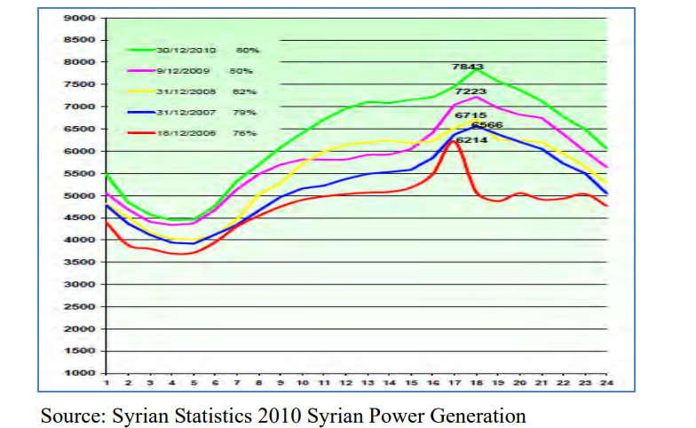
5. Load profile
[9], [10]
Vijay Bogala
Grid Code Development / Optimus Syria

Slide 14
Bibliography – Grid Code Development
[1] https://www.gses.com.au/consumer-energy-resources-and-harmonic-distortion-on-the-grid/ (accessed 08/11/2025)
[2] “Syrian Arab Republic Ministry of Electricity Public Establishment for Transmission & Distribution of Electricity Interconnection Roles Rules and Conditions for Connecting Renewable Energy Projects to the Transmission and Distribution Networks,” 2022. (accessed 08/11/2025). [Online]. Available: https://tde.gov.sy/sites/default/files/2025-07/Rules%20and%20Conditions%20for%20Connecting%20Renewable%20Energy%20Projects%20to%20the%20Transmission%20and%20Distribution%20Networks.pdf
[3]https://www.mdpi.com/19961073/16/2/916#:~:text=This%20paper%20presents%20a%20review,and%20communication%20and%20stability%20considerations. (accessed 08/11/2025)
[4]https://www.researchgate.net/publication/277328596_Renewable_Management_System_Plant_Controller_to_Manage_Grid_Codes_and_Contribute_to_the_Grid_Stability (accessed 09/11/2025)
[5] https://www.sciencedirect.com/science/article/pii/S0378779624001299 (accessed 09/11/2025)
[6] https://ieeexplore.ieee.org/document/9905351 (accessed 09/11/2025)
[7] https://www.scopetnm.com/protection-solutions/phasor-measurement-unit (accessed 09/11/2025)
[8] Open Infrastructure Map. https://openinframap.org/#10.2/34.6415/36.6817 (accessed 09/11/2025)
[9] https://www.linkedin.com/posts/georg-zachmann-8823395b_after-25-years-the-german-standard-load-profiles-activity-7312044082451701762-x-BX (accessed 08/11/2025)
[10] https://openjicareport.jica.go.jp/pdf/12058418_02.pdf (accessed 08/11/2025)
Vijay Bogala
Grid Code Development / Optimus Syria

